Slide 1
The New Modern Application Platform Session 0: Linux/UNIX Fundamentals
January 2021

Slide 2
Process navigation
Installing packages – yum
VI – file editing
Directory Navigation
Alias
SSH
sudo
cURL

Slide 3
Process Navigation
Represents an instance of a running program. When process is started when a program is initiated
Few different ways of finding information:
$ps –ef | grep <process_name>
Current running process:
$ ps
Or
$ps –au <username> / ps –ef | grep <username>
Processes can have child processes:
UID PID PPID C STIME TTY TIME CMD
root 2 0 0 05:05 ? 00:00:00 [kthreadd]
root 4 2 0 05:05 ? 00:00:00 [kworker/0:0H]
root 6 2 0 05:05 ? 00:00:00 [ksoftirqd/0]
root 7 2 0 05:05 ? 00:00:00 [migration/0]
root 8 2 0 05:05 ? 00:00:00 [rcu_bh]
Notes:
DAVID’S NOTES:
what’s the high level difference between Docker and Kubernetes?

Slide 4
Process Navigation
[kk@kk-k8 ~]$ ./touch-bunch-files.sh > /dev/null 2>&1 &
[1] 99324
[kk@kk-k8 ~]$ ls -l /tmp/tan*
-rw-rw-r--. 1 kk kk 0 Jan 13 21:20 /tmp/tanzu-rocks.0
-rw-rw-r--. 1 kk kk 0 Jan 13 21:20 /tmp/tanzu-rocks.1
-rw-rw-r--. 1 kk kk 0 Jan 13 21:20 /tmp/tanzu-rocks.2
[abbreviated list, but this will show 15 files]
Now to kill the command we run
[kk@kk-k8 ~]$ ./touch-bunch-files.sh > /dev/null 2>&1 &
[1] 99577
[kk@kk-k8 ~]$ ps -ef | grep touch
kk 99577 98732 0 21:24 pts/0 00:00:00 /bin/bash ./touch-bunch-files.sh
kk 99588 98732 0 21:24 pts/0 00:00:00 grep --color=auto touch
[kk@kk-k8 ~]$ kill 99577
[kk@kk-k8 ~]$
[1]+ Terminated ./touch-bunch-files.sh > /dev/null 2>&1
[kk@kk-k8 ~]$ ls -l /tmp/tanzu-rocks.*
-rw-rw-r--. 1 kk kk 0 Jan 13 21:24 /tmp/tanzu-rocks.0
-rw-rw-r--. 1 kk kk 0 Jan 13 21:24 /tmp/tanzu-rocks.1
-rw-rw-r--. 1 kk kk 0 Jan 13 21:24 /tmp/tanzu-rocks.2
-rw-rw-r--. 1 kk kk 0 Jan 13 21:24 /tmp/tanzu-rocks.3
-rw-rw-r--. 1 kk kk 0 Jan 13 21:24 /tmp/tanzu-rocks.4
Notes:
DAVID’S NOTES:
what’s the high level difference between Docker and Kubernetes?

Slide 5
Package management
Is a method of installing, upgrading and removing packages (or groups) on your linux system
Different approaches based on linux flavor. For e.g. yum is for RHEL variants/apt is for Debian variants.
List packages (called firefox)
$ yum list firefox
Loaded plugins: fastestmirror, langpacks
Loading mirror speeds from cached hostfile
* base: centos.s.uw.edu
* extras: mirrors.unifiedlayer.com
* updates: linux-mirrors.fnal.gov
Installed Packages
firefox.x86_64 68.12.0-1.el7.centos @updates
Available Packages
firefox.i686 78.6.1-1.el7.centos updates
firefox.x86_64 78.6.1-1.el7.centos updates
Shows installed packages and available packages.
Notes:
DAVID’S NOTES:
what’s the high level difference between Docker and Kubernetes?

Slide 6
Package management
Is a method of installing, upgrading and removing packages (or groups) on your linux system
# yum update firefox
<abbreviated output>
Updated:
firefox.x86_64 0:78.6.1-1.el7.centos
Dependency Updated:
nspr.x86_64 0:4.25.0-2.el7_9 nss.x86_64 0:3.53.1-3.el7_9 nss-softokn.x86_64 0:3.53.1-6.el7_9
nss-softokn-freebl.x86_64 0:3.53.1-6.el7_9 nss-sysinit.x86_64 0:3.53.1-3.el7_9 nss-tools.x86_64 0:3.53.1-3.el7_9
nss-util.x86_64 0:3.53.1-1.el7_9
#yum list firefox
Loaded plugins: fastestmirror, langpacks
Loading mirror speeds from cached hostfile
* base: mirrors.rcs.alaska.edu
* extras: mirrors.unifiedlayer.com
* updates: mirror.sfo12.us.leaseweb.net
Installed Packages
firefox.x86_64 78.6.1-1.el7.centos @updates
Available Packages
firefox.i686 78.6.1-1.el7.centos updates
Notes:
DAVID’S NOTES:
what’s the high level difference between Docker and Kubernetes?

Slide 7
Package management
Is a method of installing, upgrading and removing packages (or groups) on your linux system
List all packages available in the yum database
# yum list | less
List all installed packages:
#yum list installed
Removing a package
# yum remove <package-name>
Get information about a package
#yum info firefox
To find out which installed packages have updates
#yum check-update
To keep system up to date
#yum update

Slide 8
Package management
Is a method of installing, upgrading and removing packages (or groups) on your linux system
Debian/Ubuntu variant of package manager (apt):
#apt update [updates the list of available packages & versions, does NOT install or upgrade]
# apt list –-upgradeable [when run after the above command, shows the list of packages that have updates]
util-linux/focal-updates 2.34-0.1ubuntu9.1 amd64 [upgradable from: 2.34-0.1ubuntu9]
#apt upgrade util-linux
Reading package lists... Done
Building dependency tree
Reading state information... Done
Calculating upgrade... Done
The following packages will be upgraded:
apt base-files bash bsdutils fdisk gcc-10-base libapt-pkg6.0 libblkid1 libc-bin libc6 libfdisk1 libgcc-s1 libgnutls30 liblzma5 libmount1 libp11-kit0
libpam-modules libpam-modules-bin libpam-runtime libpam0g libseccomp2 libsmartcols1 libstdc++6 libsystemd0 libudev1 libuuid1 mount perl-base tar
util-linux zlib1g
31 upgraded, 0 newly installed, 0 to remove and 0 not upgraded.
Need to get 12.3 MB of archives.
After this operation, 41.0 kB of additional disk space will be used.
Do you want to continue? [Y/n] y

Slide 9
File editing – using VI
Text editor
kk@kk-k8 ~] vi name_of_file
(opens the file with vi, vi has 2 modes either input mode or command mode, when open a file with the command above, it drops you in command mode.)
Entering input mode:
i inserts at (before) current cursor position
I inserts at beginning of current line
a appends following current cursor position
A appends to end of current line
o opens up a new line after the current line
O opens up a new line previous to the current line
Entering command mode: <ESC>
Navigating a file while in command mode:
h left
j down
k up
l right
0 beginning of line
$ end of line
H top of screen
L bottom of screen
G bottom of file
<n>G the n'th line of the file
w forward a word, counting punctuation
b backward a word, counting punctuation
W forward a word, not counting punctuation
B backward a word, not counting punctuation
^F <ctrl>F forward a screen
^B <ctrl>B backward a screen
Notes:
DAVID’S NOTES:
what’s the high level difference between Docker and Kubernetes?

Slide 10
File editing – using VI
Text editor
Delete text while in command mode:
x deletes a single character (at the cursor) #x deletes the number specified in # (for example 5x deletes 4 characters)
dw deletes word (#dw, same as above example)
d$ deletes to end of line
dL deletes to bottom of screen
dG deletes from current cursor position to end of file
dd deletes current line (entirely) (#dd, same as above example with #)
Save/exit commands:
:w To save a file without exiting
:wq To save and quit
:q To quit if no changes were made
:q! quit but ignore all changes made
Notes:
DAVID’S NOTES:
what’s the high level difference between Docker and Kubernetes?

Slide 11
Directory navigation
Navigating using the command line
After logging into your linux system, you will logged into your HOME directory by default
[kk@kk-k8 ~]$ pwd [Check your current working directory]
/home/USERNAME
[kk@kk-k8 ~]$ mkdir kuberentes [Create a new Directory]
[kk@kk-k8 ~]$ cd kuberentes [Change directory to new directory]
[kk@kk-k8 ~]$ pwd
/home/kk/kuberentes [Show present working directory]
[kk@kk-k8 ~] rmdir kubernetes [Removing directory, will only work if directory is empty]
[kk@kk-k8 ~] cd [Pressing "cd" and hitting enter will take you back to the <users> home directory]
[kk@kk-k8 ~] cd - [Pressing this will take you back to the previous directory]
[kk@kk-k8 ~] ls -l [List the contents of your directory]
[kk@kk-k8 ~] cp -p filename.txt filename.backup [Copy file to make a backup and retain the permissions]
[kk@kk-k8 ~] mv filename.backup filename.current [Move a file from one location to another]
Notes:
DAVID’S NOTES:
what’s the high level difference between Docker and Kubernetes?

Slide 12
Alias
Command aliases
An alias is a shortcut to reference a specific command. It can be used for various reasons:
Shorten lengthy or frequently used commands
Change commonly typo'd commands
Change command flags to avoid mistakes
[kk@kk-k8 ~]$ kubectl get namespaces
[kk@kk-k8 ~]$ alias k='/usr/local/bin/kubectl'
[kk@kk-k8 ~]$ k get namespaces
[kk@kk-k8 ~]$ alias rm='rm -i'
Notes:
DAVID’S NOTES:
what’s the high level difference between Docker and Kubernetes?

Slide 13
ssh
CLI Protocol to securely connect from one computer to another.
Authentication is typically key-pair based and requires a private and public key
Server has the public key
Your computer will have the private key
Example: (creating a key pair on MAC)
$ssh-keygen -t rsa
Generating public/private rsa key pair.
Enter file in which to save the key (/Users/xxxxxxxxx/.ssh/id_rsa): /Users/xxxxxxxxx/.ssh/ssh_demo
Enter passphrase (empty for no passphrase): FYI this is a password for the passcode, not your server password.
Enter same passphrase again:
Your identification has been saved in /Users/xxxxxxxxx/.ssh/id_rsa.
Your public key has been saved in /Users/xxxxxxxxx/.ssh/id_rsa.pub.
The key fingerprint is:
SHA256:4jRgozlkByAKORDTDnVijP+9hqbGab9VnsM38lpsYi8 xxxxxxxxx@xxxxxxxxx-a01.vmware.com
The key's randomart image is:
+---[RSA 3072]----+
|OO= . |
|Ooo+ |
|.=o = |
| oo= o |
| +. .+ S |
| ..o.* o |
| . . .o.O * |
| = o.o.EX . |
| o.+oo .oo |
+----[SHA256]-----+
$ls -l ssh_demo*
-rw------- 1 xxxxxxxxx staff 2675 Oct 12 22:24 id_rsa [Private Key]
-rw-r--r-- 1 xxxxxxxxx staff 593 Oct 12 22:24 id_rsa.pub [Public Key]
Notes:
DAVID’S NOTES:
what’s the high level difference between Docker and Kubernetes?

Slide 14
ssh
CLI Protocol to securely connect from one computer to another.
Copy the public key to the target:
On Linux we can use the ssh-copy-id username@hostname.com [it might be installed on your MAC]
$ssh-copy-id -i id_rsa.pub kk@192.168.43.129
/usr/bin/ssh-copy-id: INFO: Source of key(s) to be installed: "id_rsa.pub"
/usr/bin/ssh-copy-id: INFO: attempting to log in with the new key(s), to filter out any that are already installed
/usr/bin/ssh-copy-id: INFO: 1 key(s) remain to be installed -- if you are prompted now it is to install the new keys
kk@192.168.43.129's password:
Number of key(s) added: 1
Now try logging into the machine, with: "ssh 'kk@192.168.43.129'"
and check to make sure that only the key(s) you wanted were added.
$ ssh kk@192.168.43.129
Last login: Thu Jan 14 11:55:19 2021 from 192.168.43.1
$ exit
logout
Connection to 192.168.43.129 closed.
If the command is not installed on your MAC, we have 2 options. Copy and paste the contents into the .ssh/authorized_keys file OR scp the file over.
Or Copy the contents of Public key file into the
Open terminal
Syntax:
ssh <username>@hostname
Notes:
DAVID’S NOTES:
what’s the high level difference between Docker and Kubernetes?

Slide 15
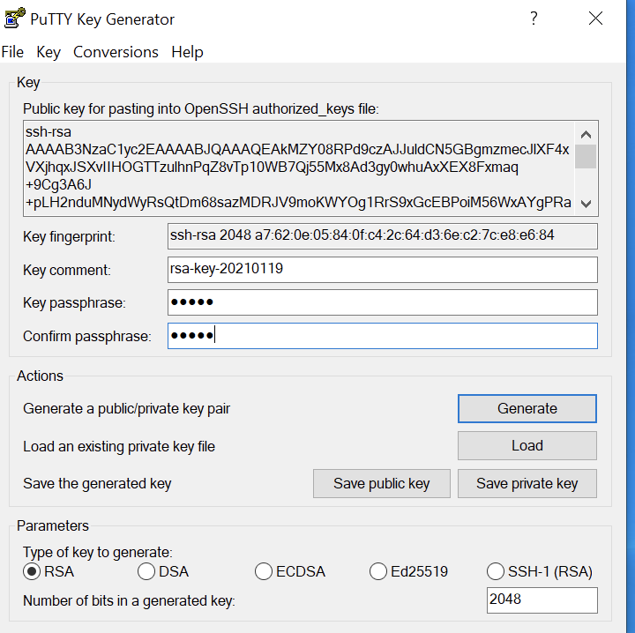
ssh
CLI Protocol to securely connect from one computer to another.
Windows examples: download putty & puttygen (www.putty.org). With puttygen downloaded, follow the instructions.
Open puttygen
Press generate [move the mouse so as to generate randomness]
Enter key passphrase (this is not a password to your destination server but a passphrase for your key, need to remember this)
Save public key
Save private key with a .ppk extension
Copy/paste the key shown in the box above into the destination machine under the username/.ssh/authorized_keys file
Notes:
DAVID’S NOTES:
what’s the high level difference between Docker and Kubernetes?

Slide 16
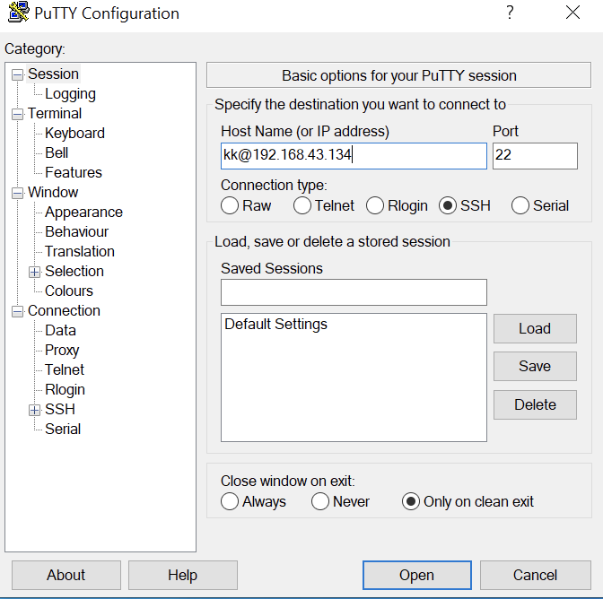
ssh
CLI Protocol to securely connect from one computer to another.
Open Putty
Enter username@hostname
Make sure ssh (port 22) is selected
Notes:
DAVID’S NOTES:
what’s the high level difference between Docker and Kubernetes?

Slide 17
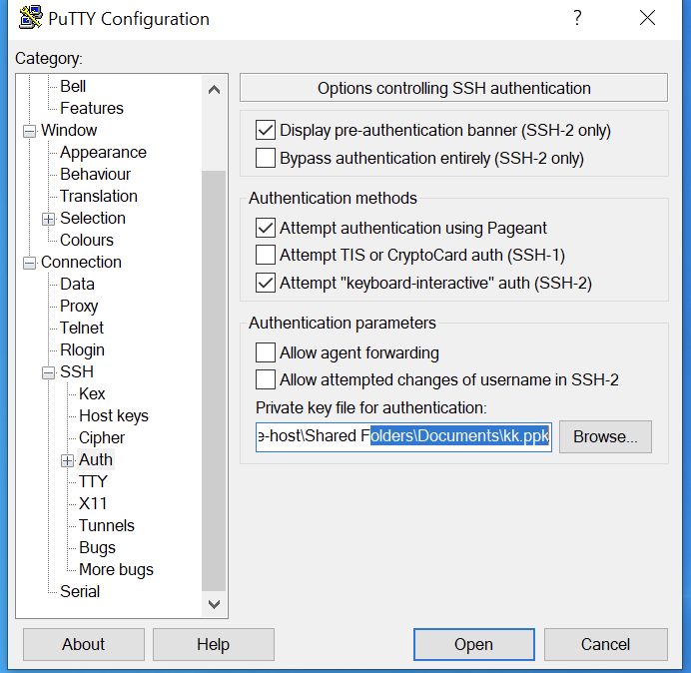
ssh
CLI Protocol to securely connect from one computer to another.
Under connection, select ssh
Browse and load previously saved
.ppk file
Notes:
DAVID’S NOTES:
what’s the high level difference between Docker and Kubernetes?

Slide 18
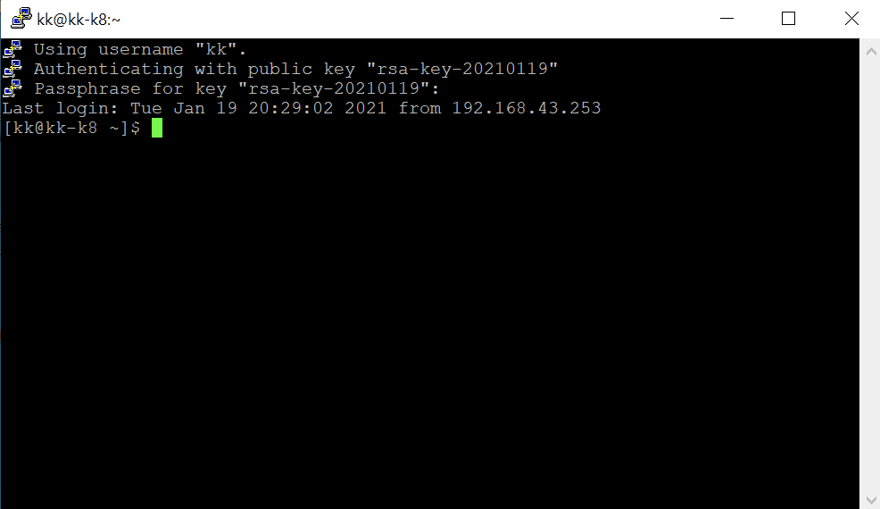
ssh
CLI Protocol to securely connect from one computer to another.
Open your session.
Notes:
DAVID’S NOTES:
what’s the high level difference between Docker and Kubernetes?

Slide 19
sudo
Sudo in a nutshell - source sudo.ws
Sudo (su "do") allows a system administrator to give certain users (or groups of users) the ability to run some (or all) commands as root while logging all commands and arguments. Sudo operates on a per-command basis, it is not a replacement for the shell.
Example:
[kk@kk-k8 ~]$ touch /root/kk
touch: cannot touch ‘/root/kk’: Permission denied
[kk@kk-k8 ~]$
[kk@kk-k8 ~]$ sudo touch /root/test
[sudo] password for kk:
[kk@kk-k8 ~]$ ls -l /root/test
ls: cannot access /root/test: Permission denied
[kk@kk-k8 ~]$ sudo ls -l /root/test
-rw-r--r--. 1 root root 0 Jan 13 21:05 /root/test
[kk@kk-k8 ~]$
[kk@kk-k8 ~]$ sudo su - root
Last login: Wed Jan 20 12:52:00 PST 2021 on pts/0
[root@kk-k8 ~]#
Notes:
DAVID’S NOTES:
what’s the high level difference between Docker and Kubernetes?

Slide 20
cURL
cURL (client URL). cURL is a command-line tool for getting or sending data including files using URL syntax
$curl www.example.com [is a working domain]
- Validation of pod connectivity
- Validation of services connectivity
- Troubleshooting
cURL bible: https://everything.curl.dev/
Notes:
DAVID’S NOTES:
what’s the high level difference between Docker and Kubernetes?

